Slide 1
Customer Segmentation using K-Means Clustering MSBA 326 Final Project Fall 2020
Submitted to Dineshkumar Kovai Balasubramanian
Dr. Bahman ZohuRI Fnu Priyansha
Golden Gate University Michael O’Donnell
Miriam O'Callaghan
Reena Sehitya

Slide 2
Introduction
Customer segmentation is the practice of partitioning a customer base into groups of individuals that have similar attributes. Each segment has customers with some common characteristics, that influences their buying behavior. According to Harvard Business School professor Clayton Christensen, “as many as 95 percent of annual product launches fail” majorly because of poor market segmentation.
This paper aims to develop a machine learning model to segment customers of an online retail company. We choose to perform behavioral segmentation using RFM clustering. RFM is based on three pillars of customer attributes: Recency of purchase, Frequency of purchase, and Monetary value of purchase. To implement the model, we will use an unsupervised machine learning algorithm called K-Means clustering.
K-means clustering is a very simple and fast algorithm, It classifies objects (customers) in multiple clusters (segments) so that customers within the same segment are as similar as possible. High level steps that we will follow for K-Means clustering includes specifying the number of clusters using elbow method, initialization of centroids by first shuffling the dataset and then randomly selecting K data points for the centroids without replacement, and then iterating until there is no change to the centroids.

Slide 3
Data Collection
The dataset used for this project is taken from Kaggle. It is a large dataset with 541909 rows and 8 columns. Each row represents one transaction and has following attributes:
Invoice number – Integer variable that represents transaction id under which the product was purchased.
Stock code – 5-digit integer variable representing each distinct product
Description – Text variable giving short description of the item
Quantity – The number of each product per transaction
Date – Date and time at which transaction was made
Unit price – Cost of a single unit of the product in sterling
Customer ID – Integer variable representing unique numeric code assigned to each customer
Country of Purchase – Nominal variable. The name of the country where customer resides

Slide 4
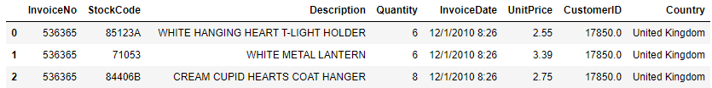
Exploratory Data Analysis and Data Preparation
Visualizing data - The below table shows the dataset contains 8 columns representing various attributes of a transaction. Of the eight columns, two can be used for exploratory analysis - Quantity, and Unit Price.
The raw data cannot be directly used for analysis. The data format, null values and outliers should be handled and the irrelevant data should be dropped before proceeding with analysis.

Slide 5
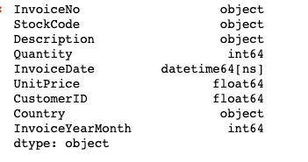
Data Cleaning
Removing Null values - There were many null values in the description and CustomerID columns. Those rows with null values were dropped since it would not make much difference in our analysis.
Datatype Formatting - To make the appropriate datatype w.r.t data, the InvoiceDate column with “object” datatype was converted to “datetime” datatype.
Column updating - Columns that were not relevant for this analysis such as StockCode, and Description are dropped. We then created a new InvoiceYearMonth field for the ease of computations, analysis, and visualization.

Slide 6
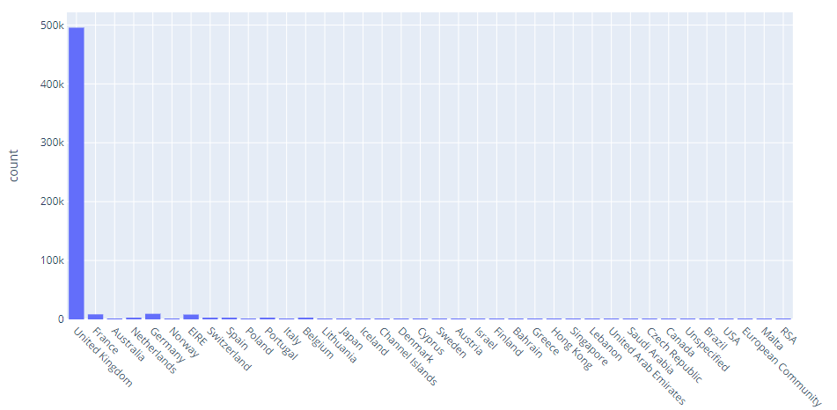
Handling Outliers
The data shows that anomalies and outliers are present in the dataset. These are influential entries that could negatively affect the accuracy of the final model score, so the outliers should be removed.
Categorical Outliers (Country) – The chart shows that over 90% of the data transactions come from the United Kingdom. Due to the lack of equal entries by country, the RFM results will be highly skewed toward transactions within the UK. To fix this situation we will narrow down our scope to include only UK transactions.

Slide 7
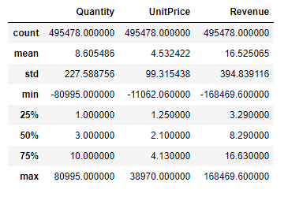
Quantitative Outliers - The below figure shows descriptive summary for the three quantitative variables, Quantity, Unit Price, and Revenue. All three variables show a small interquartile range, but an extremely large range from minimum to the maximum. This observation together with the large standard deviation illustrates the presence of outliers.

Slide 8
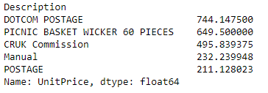
Removing Outliers from Unit Price
We found below 4 items have unusual unit price and also does not seem like a product. These items are not direct indicator of sales and are heavily skewing the data.
DOTCOM POSTAGE - seems to indicate the amount spent by the customer on postage
CRUK Commission - fee paid out to an external cancer research organization
Manual - refers to manual services rendered with the purchase like furniture assembly
Discount
The filtered observation of highest mean values brings up some suspect “products” affecting the spread of the data

Slide 9
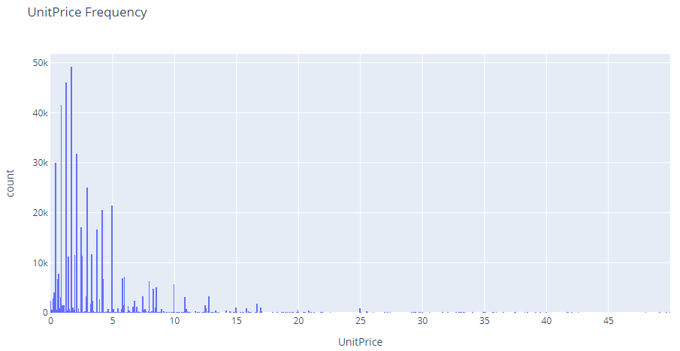
These outliers are removed and after removing outliers, our unit prices vary mostly from $0 to $1000. From the histogram chart we can see that most of the prices fall between $0 to $50 after we focused on unit prices are under 100.

Slide 10
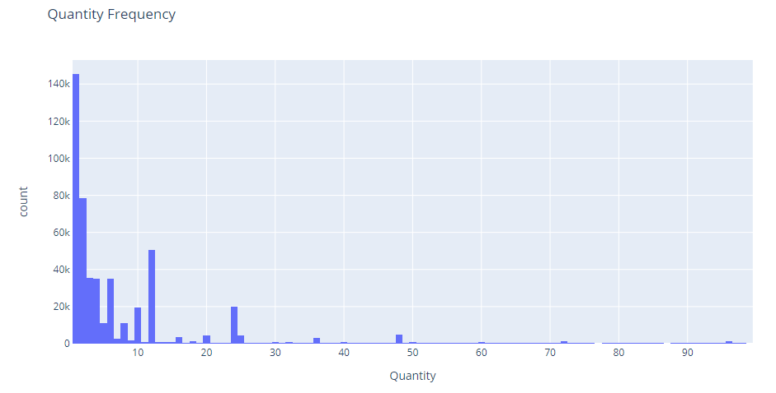
Removing Outliers from Quantity
By running a quick filter, we found that the outliers mostly lying-in small ticket items that cost around 1–2 pounds each. The most obvious outlier is invoice number 581483 that is related to product description 'PAPER CRAFT, LITTLE BIRDIE'. After further examination, we found that particular product has been returned so we decided to remove both that rows.
Overall, we found that in our dataset of 490K rows, only few transactions are for more than 1000 quantities out of which most of them have refund transactions indicating they were bought by mistake. The histogram below shows most transactions based on quantity that falls between 0 to 100.

Slide 11
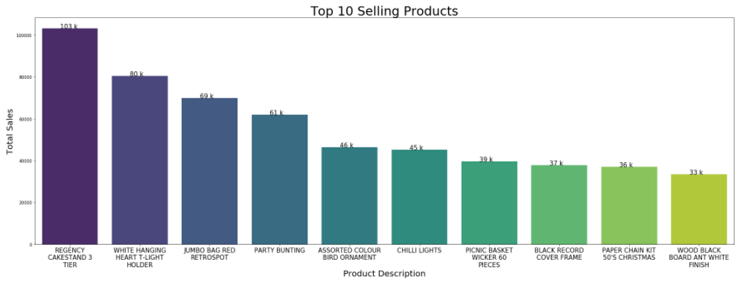
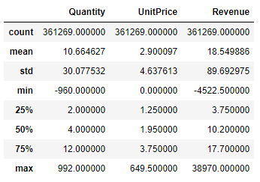
Summarizing EDA
After the outliers are removed, we can see the top ten selling products as shown in figure.
The descriptive summary has been calculated with the clean data as shown below. From the results, it is quite evident that the data looks much more balanced now with low skewness and a more manageable spread (range).

Slide 12
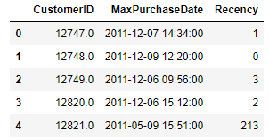
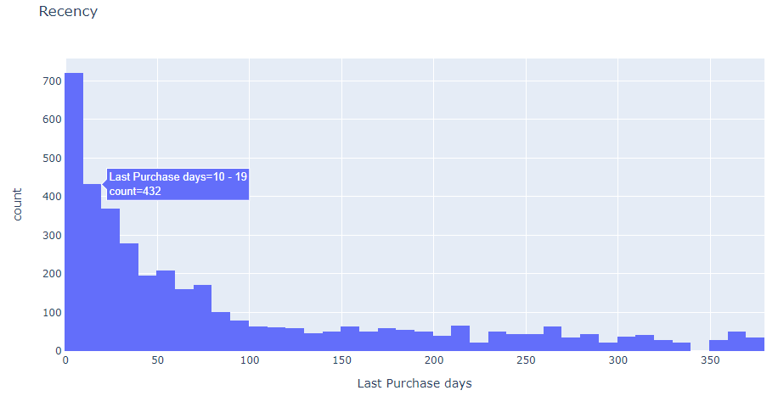
RFM Segmentation using K-Means Clustering
Recency
Calculate the Recency score of each customer:
We found the latest purchase date of the entire dataset as baseline
We found the most recent date on which every customer made the purchase and subtracted them from the baseline value found in step 1.
We then plotted these recency values on a histogram to see the distribution of number of customers in each range and found most of the customers have made purchase in the last 100 days.

Slide 13
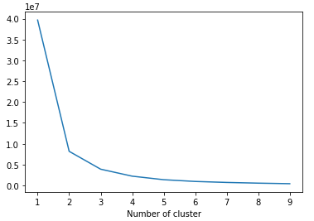
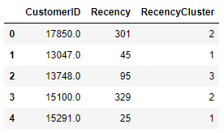
Elbow method
This method helps us to select the optimal number of clusters by fitting the model with a range of values of K.
We can plot a chart and if this line chart resembles an arm, then the elbow which is the point of inflection on curve, is the good indication that this model fits best at that point.
In the resulted plot, 3 seems the optimum number of clusters. However, we tried to expand our scope and decided to go ahead with 4 clusters of customers.
We then used K-Means clustering to assign the recency score to each customer.

Slide 14
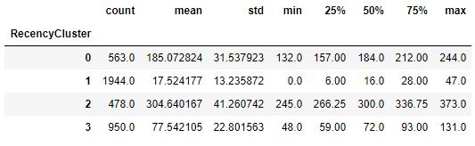
Descriptive statistics of Recency scores
All the customers are divided into 4 clusters based on their recency score.
We can see customers from cluster 3 are the most attractive customers.
The most recent purchase made by them was just 0 days ago while the oldest purchase was made within last 47 days.
On the other hand, customers in cluster 0 are the most inactive who have ordered products as earlier as 373 days ago.

Slide 15
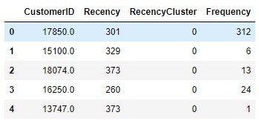
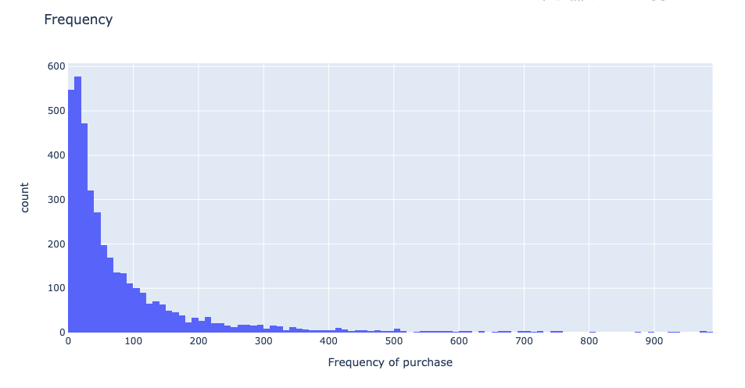
Frequency
Calculate the Frequency score of each customer:
we first find out total number of orders per customer and the frequency of the orders per customer.
We ran “uk_frequency.head()” to confirm if we have created a desired dataframe “uk_frequency” by grouping on “CustomersID” using “count” aggregate function successfully.
Then we merged uk_frequency dataframe to our generic dataframe “ukdf_user” and checked first five rows
The histogram shows the frequency of maximum number of customers is within 0-100 and beyond 200, the count of customers is tapering down. We can also see that there are some outliers present.
The pattern of frequency after 400 shows that there are a few customers whose frequency of purchasing is passing beyond 600-800 level.

Slide 16
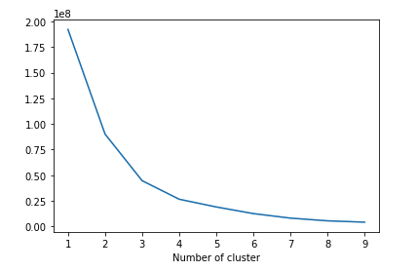
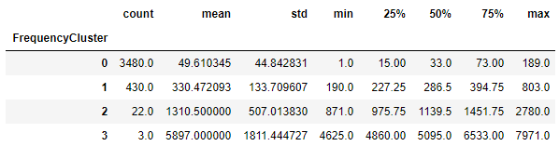
Elbow method
we ran the code to get the right number of clusters for K-Means using elbow method.
Elbow method suggests that the optimum number of clusters will be 4. Beyond that, the graph is plummeting down. We therefore decided to create 4 number of clusters.
Descriptive statistics of Frequency scores
We instantiated the instance kmeans of KMeans method and fit our “frequency” column into our model.
Performed calculations to call frequency clusters grouped by the descriptive statistics of each cluster
The cluster with maximum frequency is cluster 3 and least frequency cluster is cluster 0

Slide 17
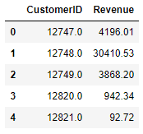
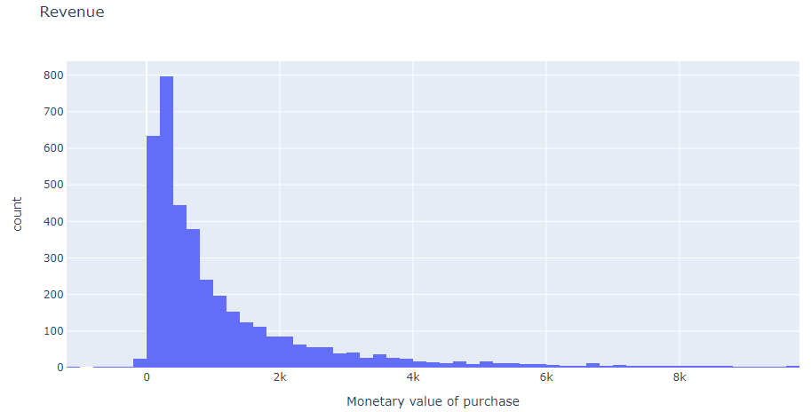
Monetary Value
Calculate the Revenue score of each customer:
We are using term Revenue to represent Monetary Value.
We first calculated the revenue for each customer and created a new dataframe “uk_revenue” grouped by CustomersID on Revenue column using “sum” aggregate function.
After checking the first five rows of uk_revenue dataframe, we merged this dataframe with our main dataframe “ukdf_user”.
We then plotted the histogram of ukdf_user (Revenue) column.

Slide 18
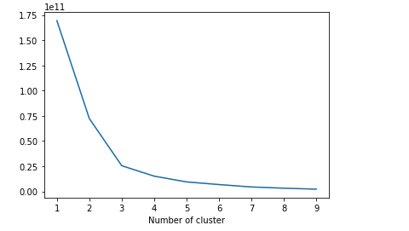
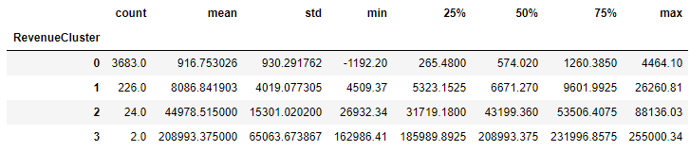
Elbow method
Elbow method suggests optimal clusters can be 3 or 4. We will create 4 clusters.
Descriptive statistics of Revenue scores
We instantiated the instance of KMeans algorithm and fit out ukdf_user (Revenue) variable into our kmeans model.
Then finally we ordered the cluster number and grouped by RevenueCluster on ukdf_user (Revenue)
The cluster 3 has maximum revenue and cluster 0 has the lowest revenue.

Slide 19
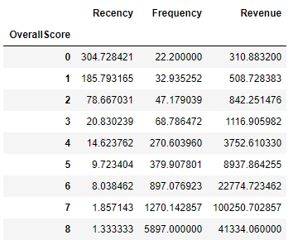
Overall Score
We have cluster numbers assigned for recency, frequency & revenue, we then created an overall score for all the clusters.
Based on the overall score, customers with score 7 are our most attractive customers and ones with score 0 are the least attractive ones.

Slide 20
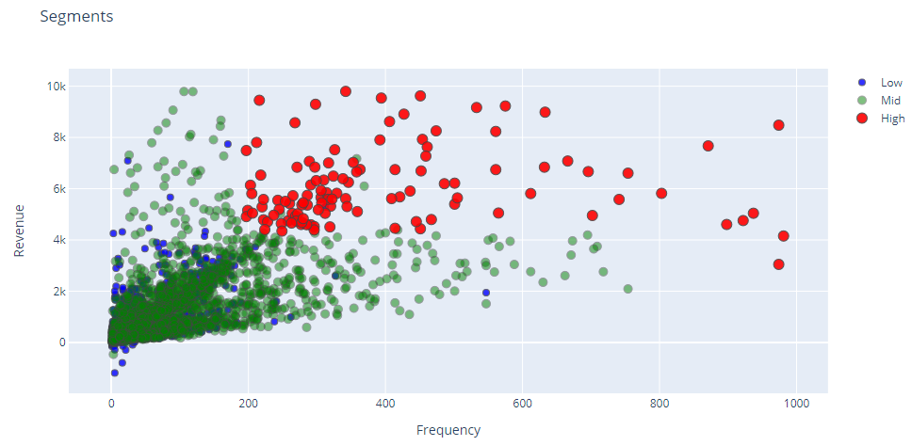
Segment Visualization
We plotted all these segments on scatter plots to identify customers with highest and lowest lifetime value. In each of the below visualizations we can see that customers in the red cluster have high prospects. On the contrary, customers in the blue cluster seem to have low prospects.
Revenue vs Frequency

Slide 21
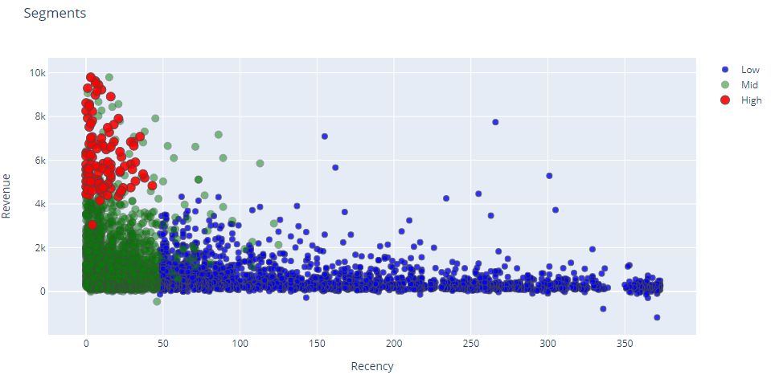
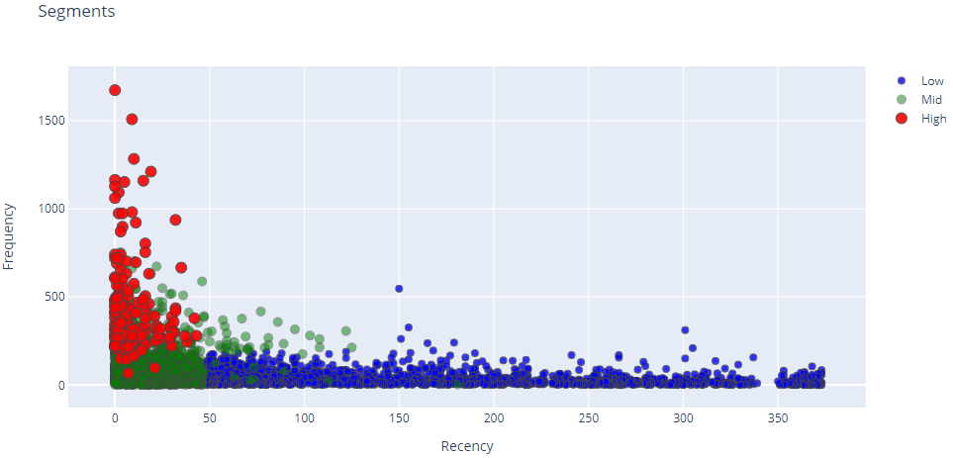
Revenue vs Recency
Frequency vs Recency

Slide 22
Findings and Conclusion
We created clusters based upon customers’ recency of purchase, the frequency, and how much money they spent on their purchases.
Based upon RFM, our study generated 8 customer categories.
Priority 1 Segment (High) – Red dots in visualization. Overall score of 6, 7 and 8. The customers in this cluster have generated revenue of $164,358 (approximately), high buying frequency of approximately 8064 times and most recent purchase with score between 1.33 to 8.
Priority 2 Segment (Mid) – Green dots in the visualization. Overall score 3, 4, and 5. The total revenue is about $13805, low as compared to Priority 1 segment but still not insignificant. The frequency of purchases is moderate and recency scores are between 9 and 20, not quite attractive.
Priority 3 Segment (Blue) – Blue dots in the visualization. Overall score 0, 1 and 2. The total revenue earned is only about $1660 and the frequency scores are also significantly low. On recency scale, this cluster looks even worse with scores as high as between 78 and 304.
Through this study, we identified that most of the promotion budget should be spent on our Priority 1 segment and the left-over resources should be used on Priority 2 segment, also not to invest our resources in priority 3 segment.
In conclusion, we can say that K-Means clustering coupled with RFM technique can help companies identify their high and low priority market segments.

Slide 23
Thank you

